Slide 1
Learning intentions and success criteria
I am learning…
I can…
About the environmental impact of computing
About security precautions
Describe ways to reduce energy usage
Describe the role of firewalls and encryption

Slide 2

Environmental Impact
N5 – Computer Systems

Slide 3
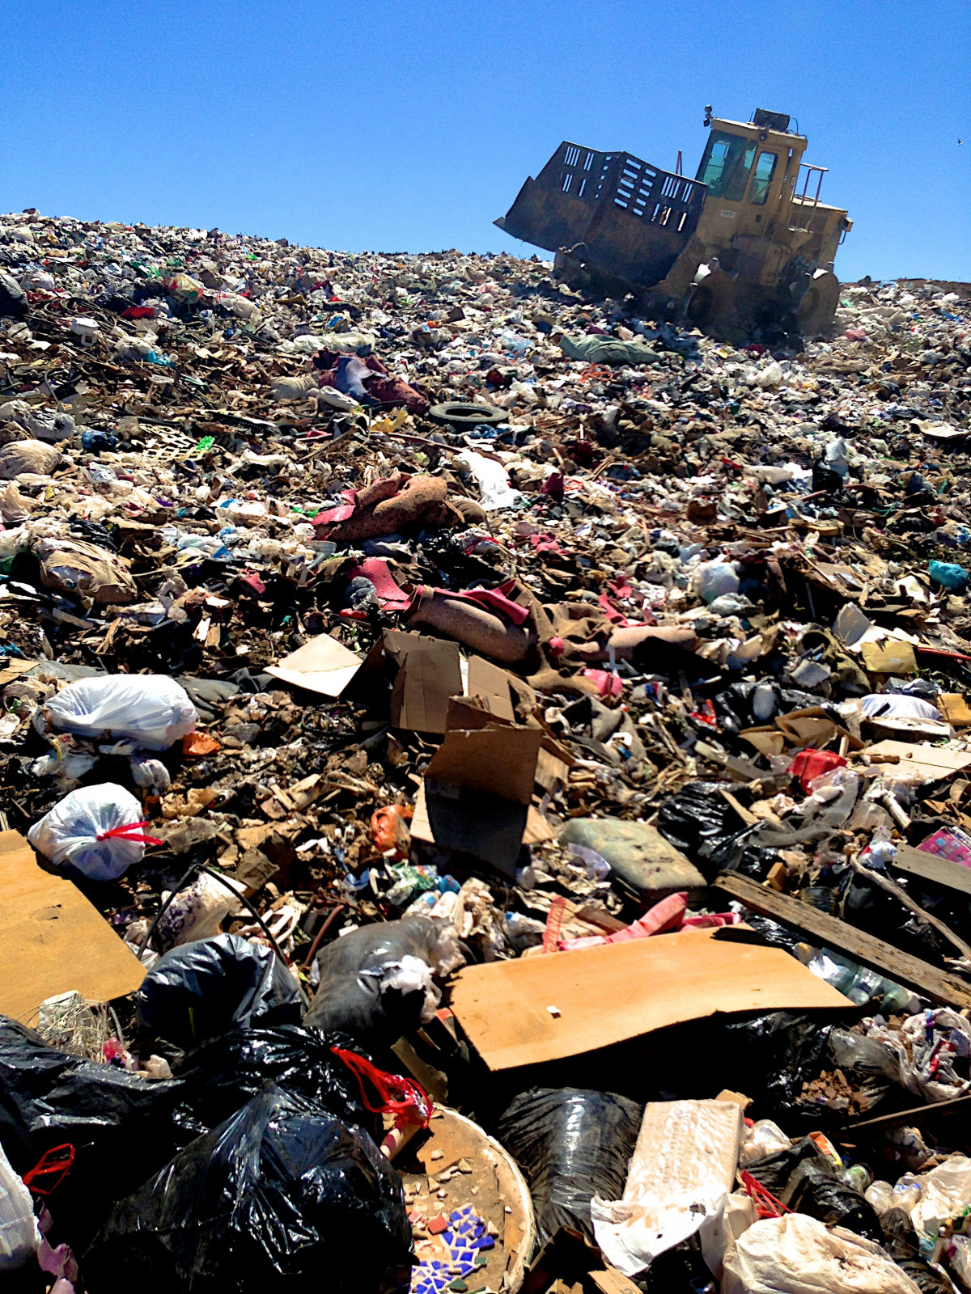
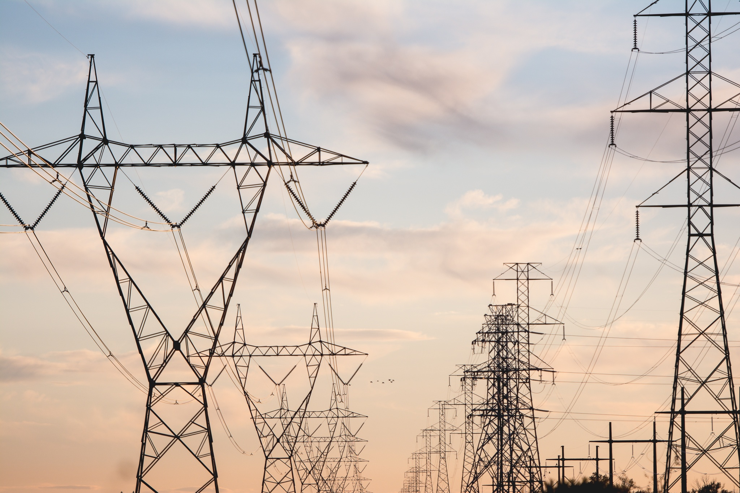
Energy Use
Computer systems use a lot of energy:
Billions of devices are in use today
Computer are eventually retired, which leads to recycling costs and the creation of landfills with e-waste
Companies are doing more and more to decrease energy consumption
3

Slide 4
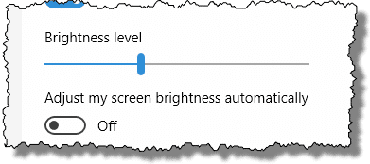
Reducing the Impact
How can the negative effect of computer systems be offset?
Power settings on monitors
Power settings on computers
4

Slide 5

Monitor Settings
Choosing monitor/display settings can save quite a lot of energy:
Set the monitor to sleep/standby after a few minutes of inactivity
Set the brightness of the monitor to a dimmer setting
5

Slide 6

Computer Settings
Power down settings:
Have your computer power down/sleep after a short period of time
On average, 50% of the power used by a computer is when it is not being used
6

Slide 7
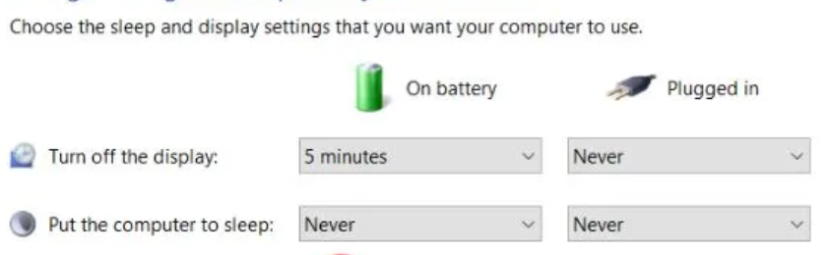
Computer Settings
Stand-by mode:
Another way to reduce the power use of your computer when you are not using it
Stand-by may turn off the display, hard-drive, or other power-consuming components
7

Slide 8
Security Precautions
N5 – Computer Systems

Slide 9
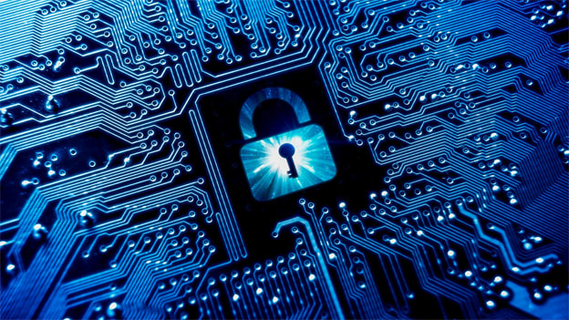
Computer Security
In National 5, you will need to know about two security precautions that computer systems may use:
The role of Firewalls
The role of Encryption
9

Slide 10
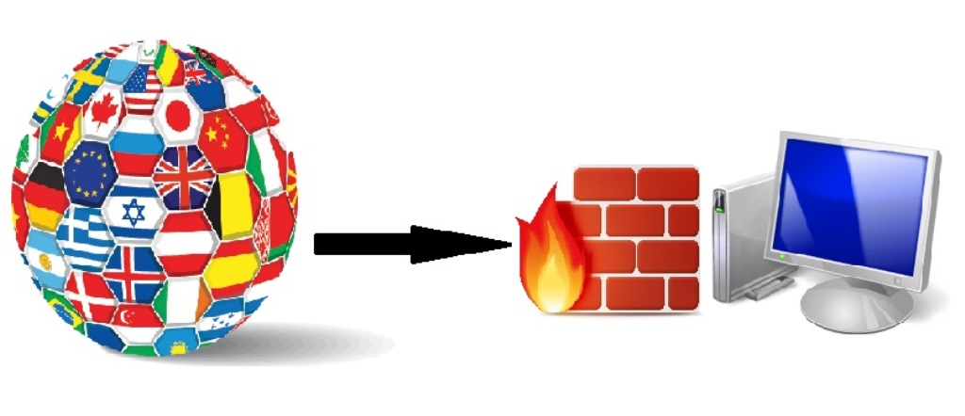
Firewalls
Used to protect a computer network from intruders:
It does this by controlling what data packets can pass through the firewall
A firewall can either be a software program or a piece of hardware
Most routers contain software that allows firewall rules to be set up
10

Slide 11
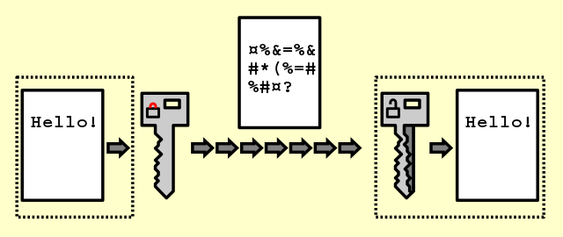
Encryption
A process of protecting data as it travels through a network:
Data is encrypted using encryption software and locked with an encryption key
Once the data is at the user’s destination, the user’s computer will decode the data using the key
Only the two ends of the network have the key, so even if data is intercepted it cannot be read
11

Slide 12
Learning intentions and success criteria
I am learning…
I can…
About the environmental impact of computing
About security precautions
Describe ways to reduce energy usage
Describe the role of firewalls and encryption

